Slide 1

Introduction to Parallel Programming
UNIT - II

Slide 2
Introduction
Motivation of Parallelism
Scope of Parallel computing.
Principles of Parallel Algorithm design:
Preliminaries
Decomposition Techniques
Characteristics of Tasks and Interactions
Mapping Techniques for Load Balancing
Methods for containing Interaction Overheads
Parallel Algorithms Models using Open MP

Slide 3
Introduction
There has been huge change in the microprocessors technology due to :-
Speed of the processor – 5M.Hz to 3.3 G Hz.
Multiple instruction in a cycle.
Increase in peak floating point operation execution rate.
Increased rate of data access to feed the processors.
Improved data path and the memory
Concurrency has accelerated computing elements. Its role in providing multiplicity of data-paths, increased access to storage elements (both memory and disk), scalable performance, and lower costs is reflected in the wide variety of applications of parallel computing.

Slide 4
Applications use many core systems.
For many design application desktop machines, engineering workstations, and compute servers have two, four, or even eight processors connected together.
Large scale applications in science and engineering rely on larger configurations of parallel computers, often comprising hundreds of processors.
Clusters of workstations are used for data intensive platforms such as database or web servers and applications such as transaction processing and data mining. They use aggregate high disk bandwidth.
Applications in graphics and visualization use multiple rendering pipes and processing elements to compute and render realistic environments with millions of polygons in real time.

Slide 5
Applications requiring high availability rely on parallel and distributed platforms for redundancy.
It is therefore extremely important, from the point of view of cost, performance, and application requirements, to understand the principles, tools, and techniques for programming the wide variety of parallel platforms currently available.

Slide 6
Introduction
Motivation of Parallelism
Scope of Parallel computing.
Principles of Parallel Algorithm design:
Preliminaries
Decomposition Techniques
Characteristics of Tasks and Interactions
Mapping Techniques for Load Balancing
Methods for containing Interaction Overheads
Parallel Algorithms Models using Open MP

Slide 7
Motivation of Parallelism
Hardware design takes very little time when compared with the development of the software. It is known that the time taken to develop parallel software is large.
Time delay to develop parallel software can be largely attributed to the inherent complexity of specifying and coordinating concurrent tasks, a lack of portable algorithms, standardized environments, and software development toolkits.
It should be noted that if it takes two years to develop a parallel application, during which time the underlying hardware and/or software platform become obsolete, the development effort is clearly wasted.
It is realized that the uniprocessor performance will not be able to sustain the performance requirement of the system.

Slide 8
Standardized hardware interfaces have reduced the turnaround time from the development of a microprocessor to a parallel machine based on the microprocessor.
Standardized programming environments has ensured a longer life-cycle for parallel applications.
All of these present compelling arguments is in favour of parallel computing platforms.

Slide 9
Introduction
Motivation of Parallelism
Scope of Parallel computing.
Principles of Parallel Algorithm design:
Preliminaries
Decomposition Techniques
Characteristics of Tasks and Interactions
Mapping Techniques for Load Balancing
Methods for containing Interaction Overheads
Parallel Algorithms Models using Open MP

Slide 10
Scope of Parallel computing.
There is a huge impact on variety of areas ranging from computational simulations for scientific and engineering applications to commercial applications in data mining and transaction processing. The cost benefits of parallelism coupled with the performance requirements of applications present compelling arguments in favour of parallel computing.
Applications in Engineering: Parallel computing is used in -
design of airfoils (optimizing lift, drag, stability),
internal combustion engines (optimizing charge distribution, burn),
high-speed circuits (layouts for delays and capacitive and inductive effects), and
structures (optimizing structural integrity, design parameters, cost, etc.), among others.

Slide 11
The other important design include micro electro-mechanical and Nano-electro-mechanical systems (MEMS and NEMS).
A mix of quantum phenomena, molecular dynamics, and stochastic and continuum models with physical processes such as conduction, convection, radiation, and structural mechanics, all in a single system use parallel computers.
At present challenges for geometric modelling, mathematical modelling, and algorithm development, all in the context of parallel computers exists.
Algorithms such as Simplex, Interior Point Method for linear optimization and Branch-and-bound, and Genetic programming for discrete optimization have been efficiently parallelized and are frequently used.

Slide 12
Scientific Applications
The sequencing of the human genome by the International Human Genome Sequencing Consortium and Celera, Inc. has opened exciting new frontiers in bioinformatics.
For biological processes functional and structural characterization of genes and proteins uses parallel algorithm.
Analysing biological sequences with a view to developing new drugs and cures for diseases and medical conditions requires innovative algorithms as well as large-scale computational power.
Some of the newest parallel computing technologies are targeted specifically towards applications in bioinformatics.
Advances in computational physics and chemistry have focused on understanding processes ranging in scale from quantum phenomena to macromolecular structures.

Slide 13
Applications in astrophysics have explored the evolution of galaxies, thermonuclear processes, and the analysis of extremely large datasets from telescopes.
Weather modelling, mineral prospecting, flood prediction, etc., rely heavily on parallel computers and have very significant impact on day-to-day life.
Commercial Applications
Parallel platforms ranging from multiprocessors to linux clusters are frequently used as web and database servers. For instance, on heavy volume days, large brokerage houses on Wall Street handle hundreds of thousands of simultaneous user sessions and millions of orders.

Slide 14
The availability of large-scale transaction data has also sparked considerable interest in data mining and analysis for optimizing business and marketing decisions.
Applications in Computer Systems
In computer security, intrusion detection is an outstanding challenge. In the case of network intrusion detection, data
is collected at distributed sites and must be analysed rapidly for signalling intrusion.
In the area of cryptography, some of the most spectacular applications of Internet-based parallel computing have focused on factoring extremely large integers.

Slide 15
A modern automobile consists of tens of processors communicating to perform complex tasks for optimizing handling and performance. In such systems, traditional parallel and distributed algorithms for leader selection, maximal independent set, etc., are frequently
used.
While parallel computing has traditionally confined itself to platforms with well behaved compute and network elements in which faults and errors do not play a significant role, there are valuable lessons that extend to computations on ad-hoc, mobile, or faulty environments.

Slide 16
Introduction
Motivation of Parallelism
Scope of Parallel computing.
Principles of Parallel Algorithm design:
Preliminaries
Decomposition Techniques
Characteristics of Tasks and Interactions
Mapping Techniques for Load Balancing
Methods for containing Interaction Overheads
Parallel Algorithms Models using Open MP

Slide 17
Principles of Parallel Algorithm design
In practice, specifying a nontrivial parallel algorithm may include some or all of the following:
Identifying portions of the work that can be performed concurrently.
Mapping the concurrent pieces of work onto multiple processes running in parallel.
Distributing the input, output, and intermediate data associated with the program.
Managing accesses to data shared by multiple processors.
Synchronizing the processors at various stages of the parallel program execution.

Slide 18
Preliminaries: Decomposition, Tasks, and Dependency Graphs
The first step in developing a parallel algorithm is to decompose the problem into tasks that can be executed concurrently
A given problem may be decomposed into tasks in many different ways.
Tasks may be of same, different, or even interment sizes.
A decomposition can be illustrated in the form of a directed graph with nodes corresponding to tasks and edges indicating that the result of one task is required for processing the next. Such a graph is called a task dependency graph.

Slide 19
Example: Multiplying a Dense Matrix with a Vector
Multiplication of a dense n x n matrix A with a vector b to yield another vector y.
Matrix - A
Product
Vector
Y
Matrix
B
0 | 1 | 2 | … | n
Task - 1
Task - 2
Task - 3
Task - n

Slide 20
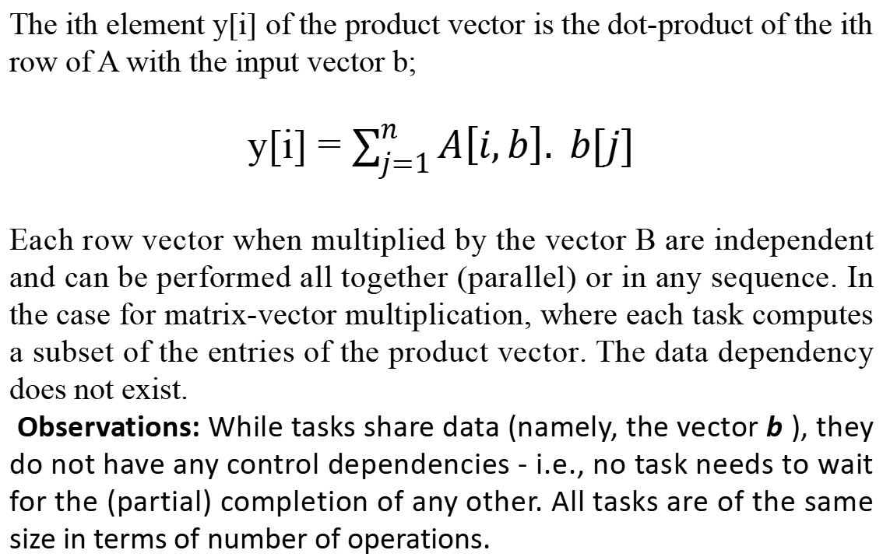
The ith element y[i] of the product vector is the dot-product of the ith row of A with the input vector b;
y[i] = $\sum_{j=1}^{n}{A\left[i,b\right]. b[j]}$
Each row vector when multiplied by the vector B are independent and can be performed all together (parallel) or in any sequence. In the case for matrix-vector multiplication, where each task computes a subset of the entries of the product vector. The data dependency does not exist.
Observations: While tasks share data (namely, the vector b ), they do not have any control dependencies - i.e., no task needs to wait for the (partial) completion of any other. All tasks are of the same size in terms of number of operations.

Slide 21
Database query processing
Consider the computations performed in processing the following query: MODEL="Civic" AND YEAR="2001" AND (COLOR = "Green" OR COLOR="White")
ID# | Model | Year | Color | Dealer | Price
4523 | Civic | 2002 | Blue | MN | $18,000
3476 | Corolla | 1999 | White | IL | $15,000
7623 | Camry | 2001 | Green | NY | $21,000
9834 | Prius | 2001 | Green | CA | $18,000
6734 | Civic | 2001 | White | OR | $17,000
5342 | Altima | 2001 | Green | FL | $19,000
3845 | Maxima | 2001 | Blue | NY | $22,000
8354 | Accord | 2000 | Green | VT | $18,000
4395 | Civic | 2001 | Red | CA | $17,000
7352 | Civic | 2002 | Red | WA | $18,000

Slide 22
The query expects for the data 2001 Civics whose colour is either green or while.
The number of intermediate table processed are:
A table Civics,
a table containing all 2001-model cars,
a table containing all green-colored cars, and
a table containing all white-colored cars.
The computation proceeds by combining these tables by computing their pairwise intersections or unions.
The various computations involved in processing the query. Each node in this figure is a task that corresponds to an intermediate table that needs to be computed and the arrows between nodes indicate dependencies between the tasks.

Slide 23
The different tables and their dependencies in a query processing operation
ID# | Year
7623 | 2001
9834 | 2001
6734 | 2001
5342 | 2001
3845 | 2001
4395 | 2001
ID# | Color
7623 | Green
9834 | Green
5342 | Green
8354 | Green
ID# | Model
4523 | Civic
6734 | Civic
4395 | Civic
ID# | Color
3476 | White
6734 | White
Civic
2001
White
Green
Civic and 2001
White or Green
ID# | Model | Year
6734 | Civic | 2001
4395 | Civic | 2001
ID# | Color
7623 | Green
9834 | Green
5342 | Green
8354 | Green
3476 | White
6734 | White
Civic and 2001 AND (White or green)
ID# | Model | Year | Color
6734 | Civic | 2001 | White

Slide 24
There are many other ways of evaluating the expression. An alternate data dependency graph for the query processing
ID# | Year
7623 | 2001
9834 | 2001
6734 | 2001
5342 | 2001
3845 | 2001
4395 | 2001
ID# | Color
7623 | Green
9834 | Green
5342 | Green
8354 | Green
ID# | Model
4523 | Civic
6734 | Civic
4395 | Civic
ID# | Color
3476 | White
6734 | White
Civic
2001
White
Green
White or Green
ID# | Color
7623 | Green
9834 | Green
5342 | Green
8354 | Green
3476 | White
6734 | White
2001 AND (White or green)
Civic and 2001 AND (White or green)
ID# | Model | Year | Color
6734 | Civic | 2001 | White

Slide 25
Granularity, Concurrency, and Task-Interaction
The number and size of tasks into which a problem is decomposed determines the granularity of the decomposition. A decomposition into a large number of small tasks is called fine-grained and a decomposition into a small number of large tasks is called coarse-grained.
Example of Fine grained:
A coarse grained counterpart to the dense matrix-vector product example. Each task in this example corresponds to the computation of three elements of the result vector.
Matrix
B
Product
Vector
Y
Matrix - A
Task - 1
0 | 1 | 2 | … | n
Task - 2
Task - 3
Task - n

Slide 26
Degree of Concurrency
The number of tasks that can be executed in parallel is the degree of concurrency of a decomposition.
Since the number of tasks that can be executed in parallel may change over program execution, the maximum degree of concurrency is the maximum number of such tasks at any point during execution.
Example: What is the maximum degree of concurrency of the database query examples?
It is four. In general, for task dependency graphs that are trees, the maximum degree of concurrency is always equal to the number of leaves in the tree.

Slide 27
The average degree of concurrency is the average number of tasks that can be processed in parallel over the execution of the program. Assuming that each tasks in the database example takes identical processing time, what is the average degree of concurrency in each decomposition?
It is two (in the first case). This is because, two operation can be done in parallel.
It is one . This is because of there is dependency to get the data from the previous query before proceeding.
The degree of concurrency increases as the decomposition becomes finer in granularity and vice versa.

Slide 28
The degree of concurrency also depends on the shape of the task-dependency graph and the same granularity, in general, does not guarantee the same degree of concurrency. For example, consider the two task graphs in
Task - 4
Task - 3
Task - 2
Task - 1
Task - 4
Task - 3
Task - 2
Task - 1
10
10
10
10
10
10
10
10
9
6
Task - 5
6
Task - 6
Task - 5
11
8
Task - 6
Task - 7
The number inside each node represents the amount of work required to complete the task corresponding to that node.
7
Task - 7

Slide 29
Critical Path Length
A directed path in the task dependency graph represents a sequence of tasks that must be processed one after the other.
The longest such path determines the shortest time in which the program can be executed in parallel.
The length of the longest path in a task dependency graph is called the critical path length.
What are the critical path lengths for the two task dependency graphs shown in the figure ?
If each task takes 10 time units, what is the shortest parallel execution time for each decomposition? How many processors are needed in each case to achieve this minimum parallel execution time? What is the maximum degree of concurrency?

Slide 30
Critical Path of Task Graph
•Critical path: The longest directed path between any pair of start node (node with no incoming edge) and finish node (node with on outgoing edges).
•Critical path length: The sum of weights of nodes along critical path.
•Average degree of concurrency = total amount of work / critical path length

Slide 31
Critical Path Length
Consider the task dependency graphs of the two database query
Decompositions. It is task-dependency graph of query processing operation
Task - 4
Task - 3
Task - 2
Task - 1
Task - 4
Task - 3
Task - 2
10
10
10
10
10
10
10
10
9
6
Task - 5
6
Task - 6
Task - 5
11
8
Task - 6
Task - 7
7
Task - 7

Slide 32
Left graph:
Critical path length = 27
Average degree of concurrency = 63/27 = 2.33
Right graph:
Critical path length = 34
Average degree of concurrency = 64/34 = 1.88
The average degree of concurrency of the task graph in Figure (a) is 2.33 and that of the task graph in Figure (b) is 1.88 although both task-dependency graphs are based on the same.

Slide 33
Limits on Parallel Performance
It would appear that the parallel time can be made arbitrarily small by making the decomposition finer in granularity.
There is an inherent bound on how fine the granularity of a computation can be. For example, in the case of multiplying a dense matrix with a vector, there can be no more than (n²) concurrent tasks.
Concurrent tasks may also have to exchange data with other tasks. This results in communication overhead. The tradeoff between the granularity of a decomposition and associated overheads often determines performance bounds.

Slide 34
Task Interaction Graphs
The tasks that a problem is decomposed into often share input, output, or intermediate data. The dependencies in a task-dependency graph usually result from the fact that the output of one task is the input for another. This factor is the interaction among tasks running on different physical processors. The dependencies in a task-dependency graph usually result from the fact that the output of one task is the input for another.
For example, in the database query example, tasks share intermediate data; the table generated by one task is often used by another task as input.
Subtasks generally exchange data with others in a decomposition. For example, even in the trivial decomposition of the dense matrix-vector product, if the vector is not replicated across all tasks, they will have to communicate elements of the vector.

Slide 35
The pattern of interaction among tasks is captured by what is known as a task-interaction graph. Here The graph of tasks (nodes) and their interactions/data exchange (edges) is referred to as a task interaction graph.
Note that task interaction graphs represent data dependencies, whereas task dependency graphs represent control dependencies.
Task Interaction Graphs: An Example
Sparse matrix-vector multiplication
Consider the problem of multiplying a sparse matrix A with a vector b. The following observations can be made:
Operation to be performed = y =Ab
Sparse A = n x n matrix
Vector b = n x 1

Slide 36
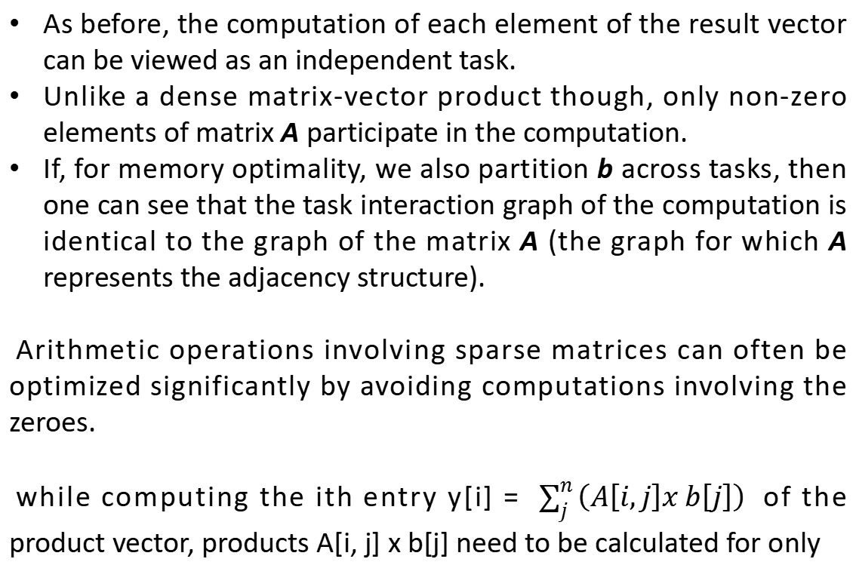
As before, the computation of each element of the result vector can be viewed as an independent task.
Unlike a dense matrix-vector product though, only non-zero elements of matrix A participate in the computation.
If, for memory optimality, we also partition b across tasks, then one can see that the task interaction graph of the computation is identical to the graph of the matrix A (the graph for which A represents the adjacency structure).
Arithmetic operations involving sparse matrices can often be optimized significantly by avoiding computations involving the zeroes.
while computing the ith entry y[i] = $\sum_{j}^{n}{\left(A\left[i,j\right]x b\left[j\right]\right) }$ of the product vector, products A[i, j] x b[j] need to be calculated for only

Slide 37
those values of j for which A[i, j] ≠ 0.
Example, y[0] = A[0, 0].b[0] + A[0, 1].b[1] + … + A[0, n] . B[n] .
One possible way of decomposing this computation is to partition the output vector y and have each task compute an entry in it.
Example:
For the given matrix, it is required to compute the product.
To compute the row 3 with the b[i] vector, it is required to assign the computation of the element y[3 ] of the output vector to Task 3. Additionally, the row A[3,*] of the matrix and
0 1 2 3 4
3 | 4 | 0 | 0 | 0
4 | 0 | 6 | 0 | 8
0 | 6 | 0 | 8 | 9
0 | 0 | 8 | 9 | 3
0 | 8 | 9 | 3 | 2
5
7
3
1
9
1
2
3
4
5
the element b[i], of the input vector is to be provided.

Slide 38
Note that the computation of y[i] requires access to many elements of b that are owned by other tasks. So Task i must get
these elements from the appropriate locations. In the message-passing paradigm, with the ownership of b[i],Task i also inherits the responsibility of sending b[i] to all the other tasks that need it for their computation.
For example, Task 3 must send b[3] to Tasks 3, 4, and 5 and must get b[3], b[4], and b[5] to perform its own computation.

Slide 39
Processes and Mapping
Process is an abstract entity that uses the code and data corresponding to a task to produce the output of that task within a finite amount of time after the task is activated by the parallel program.
In order to obtain any speedup over a sequential implementation, a parallel program must have several processes active simultaneously, working on different tasks.
The mechanism by which tasks are assigned to processes for execution is called mapping.
The task-dependency and task-interaction graphs that results form a choice of decomposition play an important role in the selection of a good mapping for a parallel algorithm.

Slide 40
The most efficient decomposition mapping combination is a single task mapped onto a single process. It wastes no time in idling or interacting, but achieves no speedup either.
Mapping of tasks onto processes plays an important role in determining how efficient the resulting parallel algorithm is.
Even though the degree of concurrency is determined by the decomposition, it is the mapping that determines how much of that concurrency is actually utilized, and how efficiently.
Note: We refer to the mapping as being from tasks to processes, as opposed to processors. This is because typical programming APIs, as we shall see, do not allow easy binding of tasks to physical processors. Rather, we aggregate tasks into processes and rely on the system to map these processes to physical processors. We use processes, not in the UNIX sense of a process, rather, simply as a collection of tasks and associated data.

Slide 41
Appropriate mapping of tasks to processes is critical to the parallel performance of an algorithm.
Mappings are determined by both the task dependency and task interaction graphs.
Task dependency graphs can be used to ensure that work is equally spread across all processes at any point (minimum idling and optimal load balance).
Task interaction graphs can be used to make sure that processes need minimum interaction with other processes (minimum communication).

Slide 42
An appropriate mapping must minimize parallel execution time by:
Mapping independent tasks to different processes.
Assigning tasks on critical path to processes as soon as they become available.
Minimizing interaction between processes by mapping tasks with dense interactions to the same process.
Note: These criteria often conflict with each other. For example, a decomposition into one task (or no decomposition at all) minimizes interaction but does not result in a speedup at all! Can you think of other such conflicting cases?

Slide 43
Mapping tasks in the database query decomposition to processes. These mappings were arrived at by viewing the dependency graph in terms of levels (no two nodes in a level have dependencies). Tasks within a single level are then assigned to different processes.
Task - 4
Task - 3
Task - 2
Task - 1
Task - 4
Task - 3
Task - 2
10
10
10
10
10
10
10
10
P3
P2
P1
P3
P1
P0
P2
P0
9
6
Task - 5
6
P2
Task - 6
Task - 5
P0
P0
P0
11
8
Task - 6
P0
Task - 7
P0
7
Figure a
Task - 7
Figure b

Slide 44
in Figure (b), if Task 5 is mapped onto process P2, then both processes P0 and P1 will need to interact with P2. In the current mapping, only a single interaction between P0 and P1 suffices.
The best way to design a parallel algorithm is to do so in two stages.
Develop a decomposition and mapping strategy suitable for the message-passing paradigm and use this to exploit parallelism among the nodes. Each task that the original matrix multiplication problem decomposes into is a matrix multiplication computation itself.
To develop a decomposition and mapping strategy suitable for the shared-memory paradigm and use this to implement each task on the multiple CPUs of a node.

Slide 45
Problem
If each task takes 10 time units, what is the shortest parallel execution time for each decomposition?
Task - 4
Task - 3
Task - 2
Task - 1
Task - 4
Task - 3
Task - 2
10
10
10
10
10
10
10
10
9
6
Task - 5
6
Task - 6
Task - 5
11
8
Task - 6
Task - 7
For the first graph it is 30 Units
For the second graph it is 40 units
7
Task - 7

Slide 46
If each task takes 1 time unit, compute:
Maximum degree of concurrency
Critical path length
Max achievable speedup

Slide 47
Introduction
Motivation of Parallelism
Scope of Parallel computing.
Principles of Parallel Algorithm design:
Preliminaries
Decomposition Techniques
Characteristics of Tasks and Interactions
Mapping Techniques for Load Balancing
Methods for containing Interaction Overheads
Parallel Algorithms Models using Open MP

Slide 48
Decomposition Techniques
So how does one decompose a task into various subtasks?
There is no single recipe that works for all problems, a set of commonly used techniques that apply to broad classes of problems. These include:
• recursive decomposition
• data decomposition
• exploratory decomposition
• speculative decomposition
Identify the data on which computations are performed.
Partition this data across various tasks.
This partitioning induces a decomposition of the problem.
Data can be partitioned in various ways - this critically impacts performance of a parallel algorithm.

Slide 49
Recursive Decomposition
Generally suited to problems that are solved using the divide-and-conquer strategy.
A given problem is first decomposed into a set of independent sub-problems.
These sub-problems are recursively decomposed further into smaller sub-problems followed by a combination of their results until a desired granularity is reached.
A classic example of a divide-and-conquer algorithm on which we
can apply recursive decomposition is Quicksort.
Consider the following data
5 | 12 | 11 | 1 | 10 | 6 | 8 | 3 | 7 | 4 | 9 | 2

Slide 50
l
h
5 | 12 | 11 | 1 | 10 | 6 | 8 | 3 | 7 | 4 | 9 | 2 | ∞
i j
Pivot = 5
if (i < j)
swap(A[i], A[j]);
}
swap(A[l], A[j]);
return j;
}
Partition (l , h)
{
Pivot = A[l]
i=l; j = h;
while (i < j)
{
do
{
i++;
} while (A[i] <= pivot);
do
{
j--;
} while (A[j] > pivot);
Quicksort(l , h)
{
if (l < h)
{
j = partition(l , h);
Quicksort(l , j);
Quicksort (j+1, h)
}
}

Slide 51
5 | 12 | 11 | 1 | 10 | 6 | 8 | 3 | 7 | 4 | 9 | 2 | ∞
1 | 3 | 4 | 2
5 | 12 | 11 | 10 | 6 | 8 | 7 | 9
1 | 2
3 | 4
5 | 6 | 8 | 7
9 | 12 | 11 | 10
1
2
3
4
5 | 6
7 | 8
9
10 | 12 | 11
5
6
7
8
10
11 | 12
In this example, once the list has been partitioned around the pivot, each sublist can be processed concurrently (i.e., each sublist represents an independent subtask). This can be repeated recursively.
11
12

Slide 52
Figure represents the task graph for the problem. Initially, there is only one sequence (i.e., the root of the tree), and only a single processor to partition it. The completion of the root task results in two subsequence (A0 and A1, corresponding to the two nodes at the first level of the tree) and each one can be partitioned in parallel. Similarly, the concurrency continues to increase as moved down the tree.
It is possible to restructure a computation to make it amenable to recursive decomposition even if the commonly used algorithm for the problem is not based on the divide and-conquer strategy.
Example, consider the problem of finding the minimum element in an unordered sequence A of n elements.

Slide 53
The serial algorithm for solving this problem scans the entire sequence A, recording at each step the minimum element found so far as illustrated in Algorithm.
It is easy to see that this serial algorithm exhibits no concurrency.
1. procedure SERIAL_MIN (A, n)
2. begin
3. min = A[0];
4. for i := 1 to n − 1 do
5. if (A[i] < min) min := A[i];
6. endfor;
7. return min;
8. end SERIAL_MIN
Modifying the algorithm by restructuring, this computation as a divide and conquer algorithm, then it can be used to perform recursive decomposition to extract concurrency.

Slide 54
a
1. procedure RECURSIVE_MIN (A, n) 2. begin 3. if ( n = 1 ) then 4. min := A [0] ; 5. else 6. lmin := RECURSIVE_MIN ( A, n/2 ); 7. rmin := RECURSIVE_MIN ( &(A[n/2]), n - n/2 ); 8. if (lmin < rmin) then 9. min := lmin; 10. else 11. min := rmin; 12. endelse; 13. endelse; 14. return min; 15. end RECURSIVE_MIN

Slide 55
In this algorithm, sequence A is split into two sub sequences, each of size n/2, and find the minimum for each of these sub sequences by performing a recursive call.
Now the overall minimum element is found by selecting the minimum of these two sub sequences. The recursion terminates when there is only one element left in each subsequence.
Having restructured the serial computation in this manner, it is easy
to construct a task-dependency graph for this problem.
Example: Draw the task-dependency graph for finding the minimum number in the sequence (4, 9, 1, 7, 8, 11, 2, 12)

Slide 56
a
Min(1,2)
Min(4,1)
Min(8,2)
Min(4,9)
Min(1,7)
Min(8,11)
Min(2, 12)
The partitioning of data can be performed in many possible ways. In general, one must explore and evaluate all possible ways of partitioning the data and determine which one yields a natural and efficient computational decomposition.
Partitioning of the output data automatically induces a decomposition of the problems into tasks, where each task is assigned the work of computing a portion of the output.

Slide 57
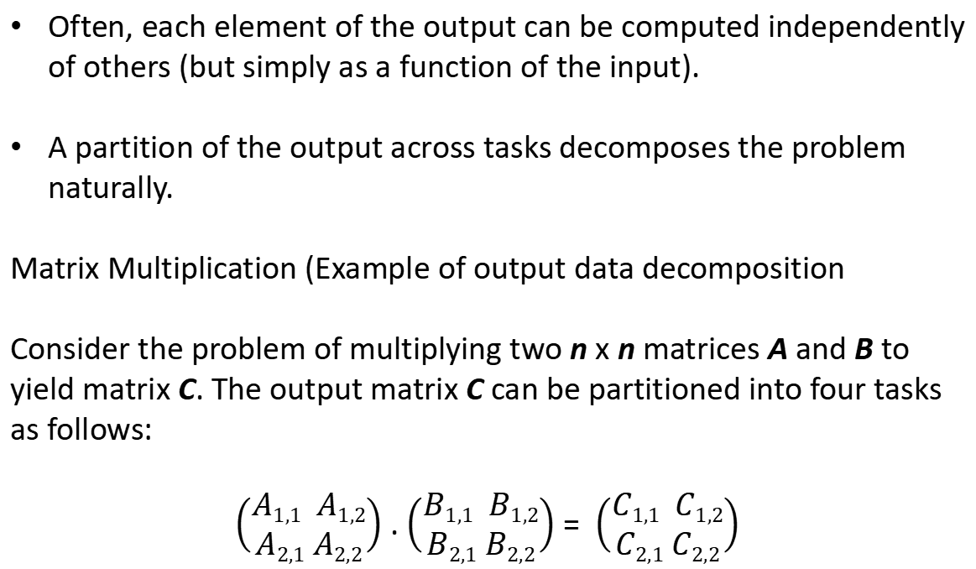
Data Decomposition: Output Data Decomposition
Often, each element of the output can be computed independently of others (but simply as a function of the input).
A partition of the output across tasks decomposes the problem naturally.
Matrix Multiplication (Example of output data decomposition
Consider the problem of multiplying two n x n matrices A and B to yield matrix C. The output matrix C can be partitioned into four tasks as follows:
$\left(\begin{aligned}A1,1 A1,2 \\ A2,1 A2,2\end{aligned}\right)$ . $\left(\begin{aligned}B1,1 B1,2 \\ B2,1 B2,2\end{aligned}\right)$ = $\left(\begin{aligned}C1,1 C1,2 \\ C2,1 C2,2\end{aligned}\right)$

Slide 58
Here matrix is decomposed based on partitioning the output matrix C.
Here matrix is vied as composed of blocks or sub-matrices and the scalar arithmetic operation in its elements are replaced by the equivalent matrix operations on the blocks.
Output matrix C is obtained by partitioning four sub-matrices and each of the four tasks computes one of these sub-matrices.
Task1: C_{1,1} = A_{1,1} B_{1,1} + A_{1,2} B_{2,1}
Task 2: C_{1,2} = A_{1,1} B_{1,2} + A_{1,2} B_{2,2}
Task 3: C_{2,1} = A_{2,1} B_{1,1} + A_{2,2} B_{2,1}
Task 4: C_{2,2} = A_{2,1} B_{1,2} + A_{2,2} B_{2,2}
A partitioning of output data does not result in a unique decomposition into tasks. For example, for the same problem as in previous foil, with identical output data distribution, we can derive the following two (other) decompositions:

Slide 59
What is the difference between decomposition of task and data decomposition?
Decomposition I | Decomposition II
Task 1: C_{1,1} = A_{1,1} B_{1,1} Task 2: C_{1,1} = C_{1,1} + A_{1,2} B_{2,1} Task 3: C_{1,2} = A_{1,1} B_{1,2} Task 4: C_{1,2} = C_{1,2} + A_{1,2} B_{2,2} Task 5: C_{2,1} = A_{2,1} B_{1,1} Task 6: C_{2,1} = C_{2,1} + A_{2,2} B_{2,1} Task 7: C_{2,2} = A_{2,1} B_{1,2} Task 8: C_{2,2} = C_{2,2} + A_{2,2} B_{2,2} | Task 1: C_{1,1} = A_{1,1} B_{1,1} Task 2: C_{1,1} = C_{1,1} + A_{1,2} B_{2,1} Task 3: C_{1,2} = A_{1,2} B_{2,2} Task 4: C_{1,2} = C_{1,2} + A_{1,1} B_{1,2} Task 5: C_{2,1} = A_{2,2} B_{2,1} Task 6: C_{2,1} = C_{2,1} + A_{2,1} B_{1,1} Task 7: C_{2,2} = A_{2,1} B_{1,2} Task 8: C_{2,2} = C_{2,2} + A_{2,2} B_{2,2}
Data decomposition aids task decomposition. Data decomposition does not result in a unique decomposition of the task. The above example shows data decomposition into 8 tasks.

Slide 60
Output Data Decomposition: Example
In this example, a transaction data base is considered. It consists of database transaction having multiple items A, B, C, D, E, F … L.
The dataset shown consists of 10 transactions. It is required to compute the frequency of the eight itemsets shown in column 2.
The actual frequencies of these itemsets in the database, which are the output of the frequency-computing program.
A, B, C, E, G, H
B,D, E, F, K, L
A, B, F, H, L
D, E,F ,H
F, G, H, K
A, E, F, K, L
B. C, D, G, H, L
G, H, L
D, E, F, K, L
F, G,H, L
Item sets
A, B, C
D, E
C, F, G
A, E
C, D
D, K
B,C,F
C, D, K
1
3
0
2
1
2
0
0
Data base transactions
Frequency

Slide 61
A, B, C, E, G, H
B,D, E, F, K, L
A, B, F, H, L
D, E,F ,H
F, G, H, K
A, E, F, K, L
B. C, D, G, H, L
G, H, L
D, E, F, K, L
F, G,H, L
Item sets
A, B, C
D, E
C, F, G
A, E
1
3
0
2
Data base transactions
Frequency
A, B, C, E, G, H
B,D, E, F, K, L
A, B, F, H, L
D, E,F ,H
F, G, H, K
A, E, F, K, L
B. C, D, G, H, L
G, H, L
D, E, F, K, L
F, G,H, L
C, D
D, K
B,C,F
C, D, K
Data base transactions
Item sets
Frequency
1
2
0
0

Slide 62
From the previous example, the following observations can be made:
If the database of transactions is replicated across the processes, each task can be independently accomplished with no communication.
If the database is partitioned across processes as well (for reasons of memory utilization), each task first computes partial counts. These counts are then aggregated at the appropriate task.
Output partitioning is not possible or desirable in many applications.
Example: While finding a minimum, maximum or the sum of a set of numbers the output is a single unknown value. It is not required or desirable for the output to partitioning.
In case of sorting algorithm, the individual elements of the output cannot be efficiently determined in isolation.

Slide 63
Input Data Partitioning
A task is associated with each input data partition. The task performs as much of the computation with its part of the data. Subsequent processing combines these partial results.
For example, while finding the sum of a sequence of N numbers using p processes (N > p), we can partition the input into p subsets of nearly equal sizes. Each task then computes the sum of the numbers in one of the subsets. Finally, the p partial results can be added up to yield the final result.
The problem of computing the frequency of a set of itemsets in a transaction database input can be decomposed based on a partitioning of input data. Each of the two tasks computes the frequencies of all the itemsets in its respective subset of transactions. The two sets of frequencies, which are the independent outputs of the two tasks, represent intermediate results. Combining the intermediate results by pairwise addition yields the final result.

Slide 64
A, B, C, E, G, H
B,D, E, F, K, L
A, B, F, H, L
D, E,F ,H
F, G, H, K
Item sets
A, B, C
D, E
C, F, G
A, E
C, D
D, K
B,C,F
C, D, K
1
2
0
1
0
1
0
0
Data base transactions
Frequency
Data base transactions
0
1
0
1
1
1
0
0
Item sets
A, B, C
D, E
C, F, G
A, E
C, D
D, K
B,C,F
C, D, K
Frequency
A, E, F, K, L
B. C, D, G, H, L
G, H, L
D, E, F, K, L
F, G,H, L

Slide 65
Partitioning Input and Output Data
Often input and output data decomposition can be combined for a higher degree of concurrency. For the itemset counting example, the transaction set (input) and itemset counts (output) can both be decomposed as follows:
Task-1 has partition of database transaction first part and item set required first part.
A, B, C, E, G, H
B,D, E, F, K, L
A, B, F, H, L
D, E,F ,H
F, G, H, K
Data base transactions
Item sets
A, B, C
D, E
C, F, G
A, E
1
3
0
1
Frequency
Task -1

Slide 66
Task – 2 consists of first part of data transaction and second part of item sets.
A, B, C, E, G, H
B,D, E, F, K, L
A, B, F, H, L
D, E,F ,H
F, G, H, K
Data base transactions
Item sets
Frequency
C, D
D, K
B,C,F
C, D, K
0
1
0
0
Task - 2
Task – 3 and task 4 consists of other two parts..

Slide 67
Data base transactions
A, B, C
D, E
C, F, G
A, E
Frequency
0
1
0
1
Item sets
A, E, F, K, L
B. C, D, G, H, L
G, H, L
D, E, F, K, L
F, G,H, L
Task - 3
Data base transactions
Item sets
Frequency
A, E, F, K, L
B. C, D, G, H, L
G, H, L
D, E, F, K, L
F, G,H, L
C, D
D, K
B,C,F
C, D, K
1
1
0
0
Task - 4

Slide 68
Each task then computes a local set of frequencies. Finally, the outputs of Tasks 1 and 3 are added together, as are the outputs of Tasks 2 and 4.
Intermediate Data Partitioning
Computation can often be viewed as a sequence of transformation from the input to the output data.
In these cases, it is often beneficial to use one of the intermediate stages as a basis for decomposition.
Partitioning intermediate data can sometimes lead to higher concurrency than partitioning input or output data.
Let us revisit the example of dense matrix multiplication. We first show how we can visualize this computation in terms of intermediate matrices D.

Slide 69
Here we see the multiplication of matrices A and B with partitioning of the three-dimensional intermediate matrix D.
A _{1,1}
A _{2,1}
B _{1,1} | B _{1,2}
D _{1,1,1} | D _{1,1,2}
D _{1,2,1} | D _{1,2,2}
*
+
D _{2,1,1} | D _{2,1,2}
D _{2,2,1} | D _{2,2,2}
A _{2,1}
A _{2,2}
B _{2,1} | B _{2,2}
*
The degree of concurrency by introducing an intermediate stage in which eight tasks compute their respective product sub-matrices and store the results in a temporary three dimensional matrix D, as shown in Figure.
C _{1,1} | C _{1,2}
C_{2,1} | C _{2,2}
The sub-matrix D_{k,i,j} is the product of A_{i,k} and B_{k,j}.

Slide 70
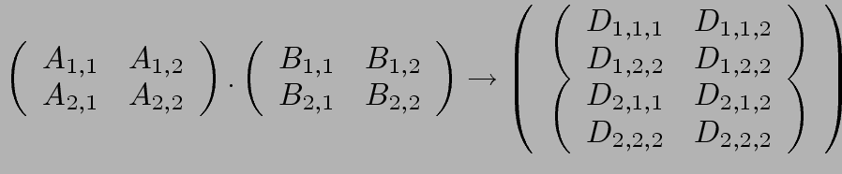
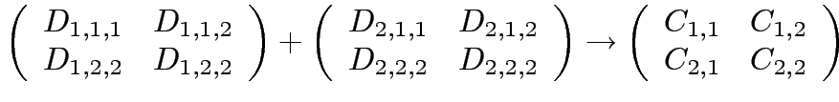
Intermediate Data Partitioning: Example
A decomposition of intermediate data structure leads to the following decomposition into 8 + 4 tasks:
Stage I
Stage II
Task 01: D_{1,1,1}= A_{1,1} B_{1,1} | Task 02: D_{2,1,1}= A_{1,2} B_{2,1}
Task 03: D_{1,1,2}= A_{1,1} B_{1,2} | Task 04: D_{2,1,2}= A_{1,2} B_{2,2}
Task 05: D_{1,2,1}= A_{2,1} B_{1,1} | Task 06: D_{2,2,1}= A_{2,2} B_{2,1}
Task 07: D_{1,2,2}= A_{2,1} B_{1,2} | Task 08: D_{2,2,2}= A_{2,2} B_{2,2}
Task 09: C_{1,1} = D_{1,1,1} + D_{2,1,1} | Task 10: C_{1,2} = D_{1,1,2} + D_{2,1,2}
Task 11: C_{2,1} = D_{1,2,1} + D_{2,2,1} | Task 12: C_{2,,2} = D_{1,2,2} + D_{2,2,2}

Slide 71
The eight tasks numbered 1 through 8 in Figure perform O(n3/8) work each in multiplying n/2 x n/2 sub-matrices of A and B. Then, four tasks numbered 9 through 12 spend O(n2/4) time each in adding the appropriate n/2 x n/2 sub-matrices of the intermediate matrix D to yield the final result matrix C.
The Owner Computes Rule
A decomposition based on partitioning output or input data is also widely referred to as the owner-computes rule.

Slide 72
The Owner Computes Rule generally states that the process assigned a particular data item is responsible for all computation associated with it.
In the case of input data decomposition, the owner computes rule implies that all computations that use the input data are performed by the process.
In the case of output data decomposition, the owner computes rule implies that the output is computed by the process to which the output data is assigned.

Slide 73
Exploratory Decomposition
In many cases, the decomposition of the problem goes hand-in-hand with its execution.
These problems typically involve the exploration (search) of a state space of solutions.
Problems in this class include a variety of discrete optimization problems (0/1 integer programming, QAP, etc.), theorem proving, game playing, etc.
Example: The 15 puzzle problem:
The 15-puzzle consists of 15 tiles numbered 1 through 15 and one blank tile placed in a 4 x 4 grid. A tile can be moved into the blank position from a position adjacent to it, thus creating a blank in the tile's original position. Depending on the configuration of the grid, up to four moves are possible: up, down, left, and right. The initial and final configurations of the tiles are specified. The objective is to determine any sequence or a shortest sequence of moves that transforms the initial configuration to the final configuration

Slide 74
A simple application of exploratory decomposition is in the solution to a 15 puzzle (a tile puzzle). We show a sequence of three moves that transform a given initial state (a) to desired final state (d).
One method for solving this problem in parallel is as follows.
First, a few levels of configurations starting from the initial configuration are generated serially until the search tree has a sufficient number of leaf nodes (i.e., configurations of the 15-puzzle). Now each node is assigned to a task to explore further

Slide 75
until at least one of them finds a solution. As soon as one of the
concurrent tasks finds a solution it can inform the others to terminate their searches. Figure illustrates one such decomposition into four tasks in which task 4 finds the solution.
1 | 2 | 3 | 4
5 | 6 | 7 | 8
9 | 10 |  | 11
13 | 14 | 15 | 12
1 | 2 | 3 | 4
5 | 6 | 7 | 8
9 | 10 | 15 | 11
13 | 14 |  | 12
1 | 2 | 3 | 4
5 | 6 |  | 8
9 | 10 | 7 | 11
13 | 14 | 15 | 12
1 | 2 | 3 | 4
5 | 6 | 7 | 8
9 |  | 10 | 11
13 | 14 | 15 | 12
1 | 2 | 3 | 4
5 | 6 | 7 | 8
9 | 10 | 11
13 | 14 | 15 | 12
Task-1 Task-2 Task-3 Task-4

Slide 76
Task -1
1 | 2 | 3 | 4
5 | 6 | 7 | 8
9 | 10 | 15 | 11
13 | 14 |  | 12
A
1 | 2 | 3 | 4
5 | 6 | 7 | 8
9 | 10 |  | 11
13 | 14 | 15 | 12
1 | 2 | 3 | 4
5 | 6 | 7 | 8
9 | 10 | 15 | 11
13 |  | 14 | 12
1 | 2 | 3 | 4
5 | 6 | 7 | 8
9 | 10 | 15 | 11
13 | 14 | 12

Slide 77
Task -2
1 | 2 | 3 | 4
5 | 6 |  | 8
9 | 10 | 7 | 11
13 | 14 | 15 | 12
1 | 2 | 3 | 4
5 |  | 6 | 8
9 | 10 | 7 | 11
13 | 14 | 15 | 12
1 | 2 | 3 | 4
5 | 6 | 8
9 | 10 | 7 | 11
13 | 14 | 15 | 12
1 | 2 | 3 | 4
5 | 6 | 7 | 8
9 | 10 |  | 11
13 | 14 | 15 | 12
1 | 2 |  | 4
5 | 6 | 3 | 8
9 | 10 | 7 | 11
13 | 14 | 15 | 12

Slide 78
Task - 3
1 | 2 | 3 | 4
5 | 6 | 7 | 8
9 |  | 10 | 11
13 | 14 | 15 | 12
1 | 2 | 3 | 4
5 | 6 | 7 | 8
9 | 10 |  | 11
13 | 14 | 15 | 12
1 | 2 | 3 | 4
5 | 6 | 7 | 8
 | 9 | 10 | 11
13 | 14 | 15 | 12
1 | 2 | 3 | 4
5 | 6 | 7 | 8
9 | 14 | 10 | 11
13 |  | 15 | 12
1 | 2 | 3 | 4
5 |  | 7 | 8
9 | 6 | 10 | 11
13 | 14 | 15 | 12

Slide 79
Task - 4
1 | 2 | 3 | 4
5 | 6 | 7 | 8
9 | 10 | 11
13 | 14 | 15 | 12
A
1 | 2 | 3 | 4
5 | 6 | 7 | 8
9 | 10 | 11 | 12
13 | 14 | 15
1 | 2 | 3 | 4
5 | 6 | 7 | 8
9 | 10 |  | 11
13 | 14 | 15 | 12
1 | 2 | 3 | 4
5 | 6 | 7
9 | 10 | 11 | 8
13 | 14 | 15 | 12

Slide 80
Difference between exploratory decomposition and data-decomposition.
The tasks induced by data-decomposition are performed in their
entirety and each task performs useful computations towards the solution of the problem.
in exploratory decomposition, unfinished tasks can be terminated as soon as an overall solution is found.
The work performed by the parallel formulation can be either smaller or greater than that performed by the serial algorithm.
For example, consider a search space that has been partitioned into four concurrent tasks as shown in Figure.

Slide 81
m
m
m
m
m
m
m
m
figure – a
Total serial work = 2m+1
Total Parallel work = 1
figure - b
Total serial work = m
Total Parallel work = 4m
If the solution lies right at the beginning of the search space corresponding to task 3 as shown in figure - a, then it will be found almost immediately by the parallel formulation.
The serial algorithm would have found the solution only after performing work equivalent to searching the entire space corresponding to tasks 1 and 2.
On the other hand, if the solution lies towards the end of the search space corresponding to task as in figure - b, then the parallel formulation will perform almost four times the work of the serial algorithm and will yield no speedup.

Slide 82
Speculative Decomposition
Speculative decomposition is used when a program may take one of many possible computationally significant branches depending on the output of other computations that precede it.
In this situation, while one task is performing the computation whose output is used in deciding the next computation, other tasks can concurrently start the computations of the next stage.
This is similar to switch statement. When the input for the switch has finally been computed, the computation corresponding to the correct branch would be used while that corresponding to the other branches would be discarded. In order to minimize the wasted computation, a slightly different formulation of speculative decomposition could be used, especially in situations where one of the outcomes of the switch is more likely than the others. In this case, only the most promising branch is taken up a task in parallel with the preceding computation.

Slide 83
In some applications, dependencies between tasks are not known a-priori.
For such applications, it is impossible to identify independent tasks.
There are generally two approaches to dealing with such applications: conservative approaches, which identify independent tasks only when they are guaranteed to not have dependencies, and, optimistic approaches, which schedule tasks even when they may potentially be erroneous.
Conservative approaches may yield little concurrency and optimistic approaches may require roll-back mechanism in the case of an error.

Slide 84
Speculative Decomposition: Example
A classic example of speculative decomposition is in discrete event simulation.
The central data structure in a discrete event simulation is a time-ordered event list.
Events are extracted precisely in time order, processed, and if required, resulting events are inserted back into the event list.
Considering today as a discrete event system – a person gets up, get ready, drive to work, work, eat lunch, work some more, drive back, eat dinner, and sleep.
Each of these events may be processed independently, however, in driving to work, that person might meet with an unfortunate accident and not get to work at all.
Therefore, an optimistic scheduling of other events will have to be rolled back.

Slide 85
Parallel discrete event simulation
Consider the simulation of a system that is represented as a network or a directed graph. The nodes of this network represent components.
A component has to wait if the input buffer of one of its outgoing neighbors if full, until that neighbor picks up a job to create space in the buffer. There is a finite number of input job types.
The output of a component (and hence the input to the components connected to it) and the time it takes to process a job is a function of the input job.
The problem is to simulate the functioning of the network for a given sequence or a set of sequences of input jobs and compute the total completion time and possibly other aspects of system behavior.

Slide 86
System Components
C
System Inputs
System Outputs
A
D
E
G
I
B
F
H
The problem of simulating a sequence of input jobs on the network described in figure above appears inherently sequential because the input of a typical component is the output of another.

Slide 87
Speculative decomposition is different from exploratory decomposition in the following way.
In speculative decomposition, the input at a branch leading to multiple parallel tasks is unknown, whereas in exploratory decomposition, the output of the multiple tasks originating at a branch is unknown.
In speculative decomposition, the serial algorithm would strictly perform only one of the tasks at a speculative stage because when it reaches the beginning of that stage, it knows exactly which branch to take. Therefore, by preemptively computing for multiple possibilities out of which only one materializes, a parallel program employing speculative decomposition performs more aggregate work than its serial counterpart.
In exploratory decomposition, the serial algorithm too may explore different alternatives one after the other.

Slide 88
If only one of the possibilities is explored speculatively, the parallel algorithm may perform more or the same amount of work as the serial algorithm. On the other hand, in exploratory decomposition, the serial algorithm too may explore different alternatives one after the other, because the branch that may lead to the solution is not known beforehand. Therefore, the parallel program may perform more, less, or the same amount of aggregate work compared to the serial algorithm depending on the location of the solution in the search space.
Hybrid Decompositions
Often, a mix of decomposition techniques is necessary for decomposing a problem. Consider the following examples:
In quicksort, recursive decomposition alone limits concurrency. A mix of data and recursive decompositions is more desirable.

Slide 89
In discrete event simulation, there might be concurrency in task processing. A mix of speculative decomposition and data decomposition may work well.
Even for simple problems like finding a minimum of a list of numbers, a mix of data and recursive decomposition works well.

Slide 90
Introduction
Motivation of Parallelism
Scope of Parallel computing.
Principles of Parallel Algorithm design:
Preliminaries
Decomposition Techniques
Characteristics of Tasks and Interactions
Mapping Techniques for Load Balancing
Methods for containing Interaction Overheads
Parallel Algorithms Models using Open MP

Slide 91
A Characteristics of Tasks and Interactions
This topic is to discuss the various properties of tasks and inter-task interactions that affect the choice of a good mapping.
Once a problem has been decomposed into independent tasks, the characteristics of these tasks critically impact choice and performance of parallel algorithms. Relevant task characteristics include:
Task generation.
Task sizes.
Size of data associated with tasks.
The tasks that constitute a parallel algorithm may be generated either statically or dynamically.

Slide 92
Static task generation: Concurrent tasks can be identified a-priori. Typical matrix operations, graph algorithms, image processing applications, and other regularly structured problems fall in this class. These can typically be decomposed using data or recursive decomposition techniques.
Dynamic task generation: Certain decomposition lead to dynamic task generation during the execution of the algorithm. Recursive decomposition can lead to dynamic task generation.
In other words, tasks are generated as computation progresses. A classic example of this is in game playing - each 15 puzzle board is generated from the previous one. These applications are typically decomposed using exploratory or speculative decompositions.

Slide 93
Task Sizes
Task size is required to find the relative amount of time required to complete it. This characteristic influences the choice of mapping scheme.
Task sizes may be uniform (i.e., all tasks are the same size) or non-uniform. Example: Matrix multiplication tasks are uniform and quick sort tasks are non-uniform.
Non-uniform task sizes may be such that they can be determined (or estimated) a-priori or not.
Examples in this class include discrete optimization problems, in which it is difficult to estimate the effective size of a state space.

Slide 94
Size of Data Associated with Tasks
The size of data associated with task is an important consideration for mapping is that the data associated with a task must be available to the process performing that task, and the size and the location of these data may determine the process that can perform the task without incurring excessive data-movement overheads.
The size of data associated with a task may be small or large when viewed in the context of the size of the task.
A small context of a task implies that an algorithm can easily communicate this task to other processes dynamically (e.g., the 15 puzzle). For example, the input to a task in the 15-puzzle problem may be just one state of the puzzle. This is a small input relative to the amount of computation that may be required to find a sequence of moves from this state to a solution state.

Slide 95
A large context ties the task to a process, or alternately, an algorithm may attempt to reconstruct the context at another processes as opposed to communicating the context of the task (e.g., 0/1 integer programming).
In the problem of computing the minimum of a sequence, the size of the input is proportional to the amount of computation, but the output is just one number.
In the parallel formulation of the quick sort, the size of both the input and the output data is of the same order as the sequential time needed to solve the task.

Slide 96
Characteristics of Task Interactions
Tasks need to interact with each other to share data, work, or synchronization information. Different parallel algorithms require different types of interactions among concurrent tasks. The nature of these interactions makes them more suitable for certain programming paradigms and mapping schemes, and less suitable for others.
Tasks may communicate with each other in various ways. The associated dichotomy is:
Static interactions: The tasks and their interactions are known a-priori. These are relatively simpler to code into programs.
Dynamic interactions: The timing or interacting tasks cannot be determined a-priori. These interactions are harder to code, especially, as we shall see, using message passing APIs.

Slide 97
Characteristics of Task Interactions
Regular interactions: There is a definite pattern (in the graph sense) to the interactions. These patterns can be exploited for efficient implementation.
Irregular interactions: Interactions lack well-defined topologies.

Slide 98
Characteristics of Task Interactions: Example
A simple example of a regular static interaction pattern is in image dithering. The underlying communication pattern is a structured (2-D mesh) one as shown here:

Slide 99
Characteristics of Task Interactions: Example
The multiplication of a sparse matrix with a vector is a good example of a static irregular interaction pattern. Here is an example of a sparse matrix and its associated interaction pattern.

Slide 100
Characteristics of Task Interactions
Interactions may be read-only or read-write.
In read-only interactions, tasks just read data items associated with other tasks.
In read-write interactions tasks read, as well as modify data items associated with other tasks.
In general, read-write interactions are harder to code, since they require additional synchronization primitives.

Slide 101
Characteristics of Task Interactions
Interactions may be one-way or two-way.
A one-way interaction can be initiated and accomplished by one of the two interacting tasks.
A two-way interaction requires participation from both tasks involved in an interaction.
One way interactions are somewhat harder to code in message passing APIs.

Slide 102
Mapping Techniques
Once a problem has been decomposed into concurrent tasks, these must be mapped to processes (that can be executed on a parallel platform).
Mappings must minimize overheads.
Primary overheads are communication and idling.
Minimizing these overheads often represents contradicting objectives.
Assigning all work to one processor trivially minimizes communication at the expense of significant idling.

Slide 103
Mapping Techniques for Minimum Idling
Mapping must simultaneously minimize idling and load balance. Merely balancing load does not minimize idling.

Slide 104
Mapping Techniques for Minimum Idling
Mapping techniques can be static or dynamic.
Static Mapping: Tasks are mapped to processes a-priori. For this to work, we must have a good estimate of the size of each task. Even in these cases, the problem may be NP complete.
Dynamic Mapping: Tasks are mapped to processes at runtime. This may be because the tasks are generated at runtime, or that their sizes are not known.
Other factors that determine the choice of techniques include the
size of data associated with a task and the nature of underlying
domain.

Slide 105
Schemes for Static Mapping
Mappings based on data partitioning.
Mappings based on task graph partitioning.
Hybrid mappings.

Slide 106
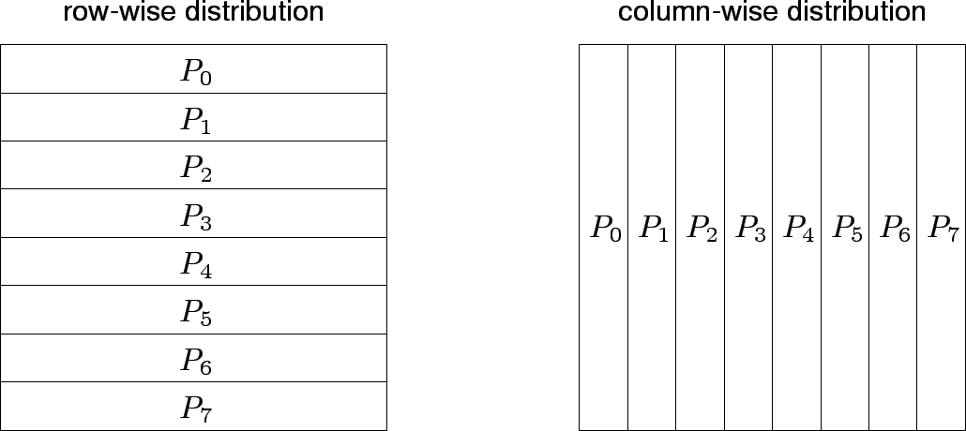
Mappings Based on Data Partitioning
We can combine data partitioning with the ``owner-computes'' rule to partition the computation into subtasks. The simplest data decomposition schemes for dense matrices are 1-D block distribution schemes.

Slide 107
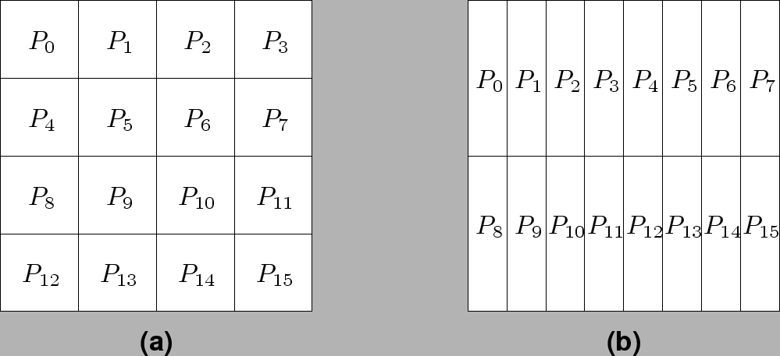
Block Array Distribution Schemes
Block distribution schemes can be generalized to higher dimensions as well.

Slide 108
Block Array Distribution Schemes: Examples
For multiplying two dense matrices A and B, we can partition the output matrix C using a block decomposition.
For load balance, we give each task the same number of elements of C. (Note that each element of C corresponds to a single dot product.)
The choice of precise decomposition (1-D or 2-D) is determined by the associated communication overhead.
In general, higher dimension decomposition allows the use of larger number of processes.

Slide 109
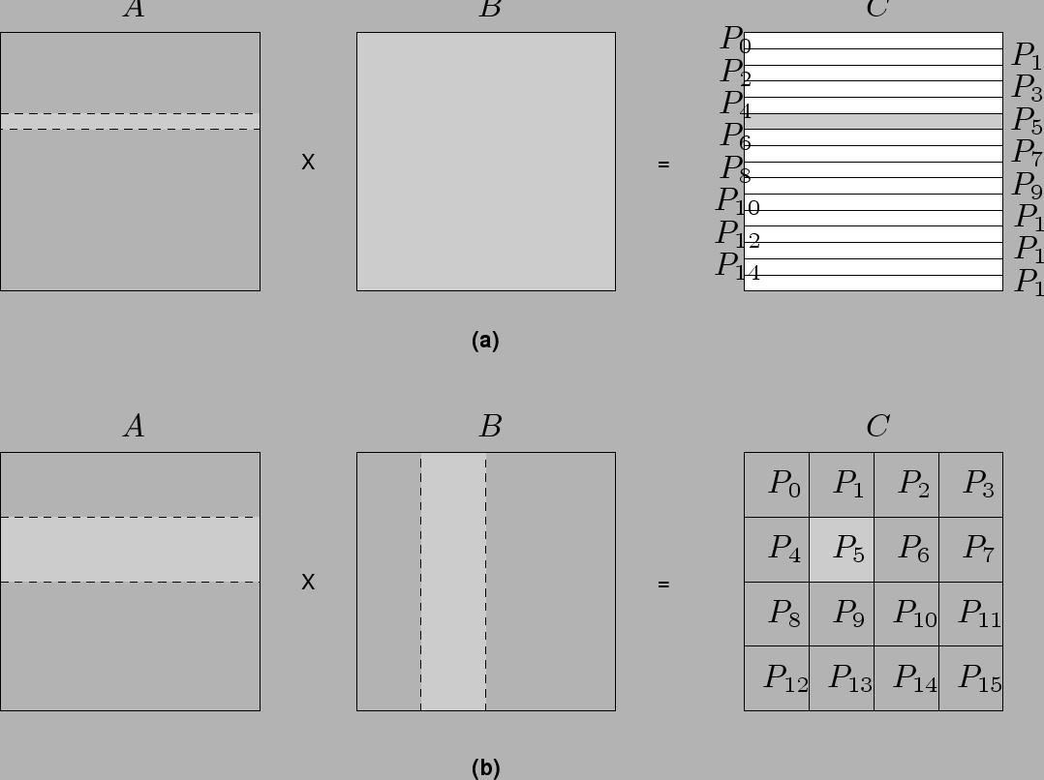
Data Sharing in Dense Matrix Multiplication

Slide 110
Cyclic and Block Cyclic Distributions
If the amount of computation associated with data items varies, a block decomposition may lead to significant load imbalances.
A simple example of this is in LU decomposition (or Gaussian Elimination) of dense matrices.

Slide 111
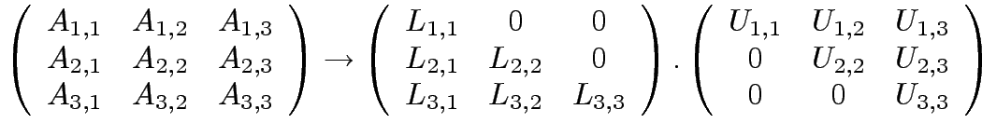














LU Factorization of a Dense Matrix
A decomposition of LU factorization into 14 tasks - notice the
significant load imbalance.
1: 2: 3: 4: 5: | 6: 7: 8: 9: 10: | 11: 12: 13: 14:

Slide 112
Block Cyclic Distributions
Variation of the block distribution scheme that can be used to alleviate the load-imbalance and idling problems.
Partition an array into many more blocks than the number of available processes.
Blocks are assigned to processes in a round-robin manner so that each process gets several non-adjacent blocks.

Slide 113
Block-Cyclic Distribution for Gaussian Elimination
The active part of the matrix in Gaussian Elimination changes. By assigning blocks in a block-cyclic fashion, each processor receives blocks from different parts of the matrix.

Slide 114
Block-Cyclic Distribution: Examples
One- and two-dimensional block-cyclic distributions among 4 processes.

Slide 115
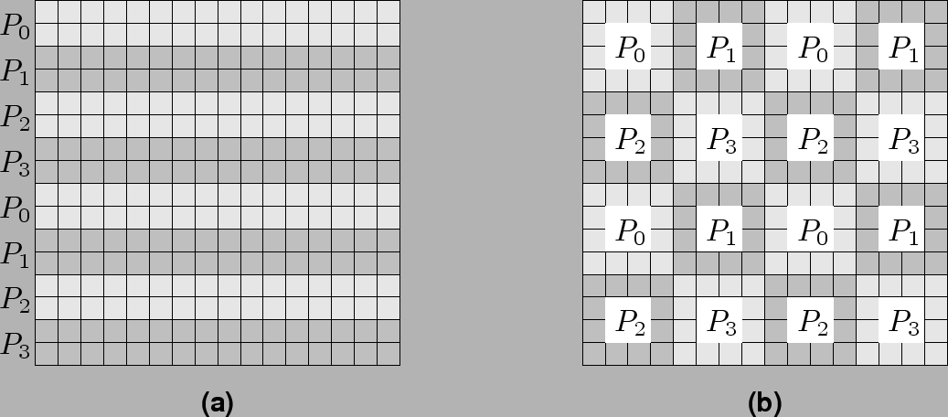
Block-Cyclic Distribution
A cyclic distribution is a special case in which block size is one.
A block distribution is a special case in which block size is n/p , where n is the dimension of the matrix and p is the number of processes.

Slide 116
Graph Partitioning Dased Data Decomposition
In case of sparse matrices, block decompositions are more complex.
Consider the problem of multiplying a sparse matrix with a vector.
The graph of the matrix is a useful indicator of the work (number of nodes) and communication (the degree of each node).
In this case, we would like to partition the graph so as to assign equal number of nodes to each process, while minimizing edge count of the graph partition.

Slide 117
Partitioning the Graph of Lake Superior
Random Partitioning
Partitioning for minimum edge-cut.

Slide 118
Mappings Based on Task Paritioning
Partitioning a given task-dependency graph across processes.
Determining an optimal mapping for a general task-dependency graph is an NP-complete problem.
Excellent heuristics exist for structured graphs.

Slide 119
Task Paritioning: Mapping a Binary Tree Dependency Graph
Example illustrates the dependency graph of one view of quick-sort
and how it can be assigned to processes in a hypercube.

Slide 120
Task Paritioning: Mapping a Sparse Graph
Sparse graph for computing a sparse matrix-vector product and its mapping.

Slide 121
Hierarchical Mappings
Sometimes a single mapping technique is inadequate.
For example, the task mapping of the binary tree (quicksort) cannot use a large number of processors.
For this reason, task mapping can be used at the top level and data partitioning within each level.

Slide 122
An example of task partitioning at top level with data partitioning at the lower level.

Slide 123
Schemes for Dynamic Mapping
Dynamic mapping is sometimes also referred to as dynamic load balancing, since load balancing is the primary motivation for dynamic mapping.
Dynamic mapping schemes can be centralized or distributed.

Slide 124
Centralized Dynamic Mapping
Processes are designated as masters or slaves.
When a process runs out of work, it requests the master for more work.
When the number of processes increases, the master may become the bottleneck.
To alleviate this, a process may pick up a number of tasks (a chunk) at one time. This is called Chunk scheduling.
Selecting large chunk sizes may lead to significant load imbalances as well.
A number of schemes have been used to gradually decrease chunk size as the computation progresses.

Slide 125
Distributed Dynamic Mapping
Each process can send or receive work from other processes.
This alleviates the bottleneck in centralized schemes.
There are four critical questions: how are sensing and receiving processes paired together, who initiates work transfer, how much work is transferred, and when is a transfer triggered?
Answers to these questions are generally application specific. We will look at some of these techniques later in this class.

Slide 126
Minimizing Interaction Overheads
Maximize data locality: Where possible, reuse intermediate data. Restructure computation so that data can be reused in smaller time windows.
Minimize volume of data exchange: There is a cost associated with each word that is communicated. For this reason, we must minimize the volume of data communicated.
Minimize frequency of interactions: There is a startup cost associated with each interaction. Therefore, try to merge multiple interactions to one, where possible.
Minimize contention and hot-spots: Use decentralized techniques, replicate data where necessary.

Slide 127
Minimizing Interaction Overheads (continued)
Overlapping computations with interactions: Use non-blocking communications, multithreading, and prefetching to hide latencies.
Replicating data or computations.
Using group communications instead of point-to-point primitives.
Overlap interactions with other interactions.

Slide 128
Parallel Algorithm Models
An algorithm model is a way of structuring a parallel algorithm by selecting a decomposition and mapping technique and applying the appropriate strategy to minimize interactions.
Data Parallel Model: Tasks are statically (or semi-statically) mapped to processes and each task performs similar operations on different data.
Task Graph Model: Starting from a task dependency graph, the interrelationships among the tasks are utilized to promote locality or to reduce interaction costs.

Slide 129
Parallel Algorithm Models (continued)
Master-Slave Model: One or more processes generate work and allocate it to worker processes. This allocation may be static or dynamic.
Pipeline / Producer-Comsumer Model: A stream of data is passed through a succession of processes, each of which perform some task on it.
Hybrid Models: A hybrid model may be composed either of multiple models applied hierarchically or multiple models applied sequentially to different phases of a parallel algorithm.

